Slide 1
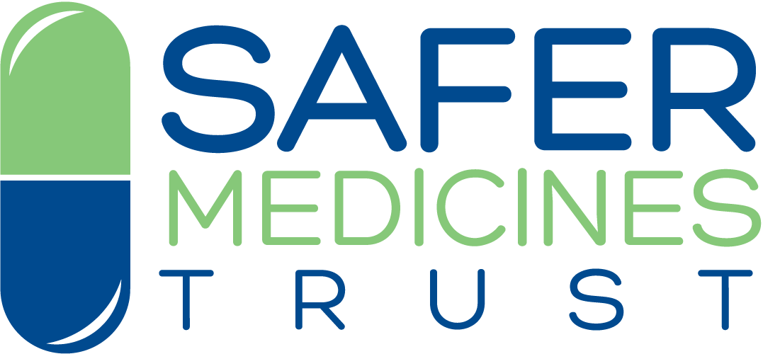
Are researchers moving away from animal models as a result of poor clinical translation in the field of stroke? An analysis of opinion papers
Pandora Pound
Research Consultant, Safer Medicines Trust, UK
Utrecht 27 November 2019

Slide 2
Overview
Problem of poor animal to human translation in field of stroke
What scientists working in this field think about the problem of poor translation
Any evidence of move away from animal models in this field?

Slide 3
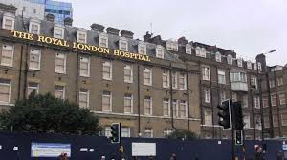
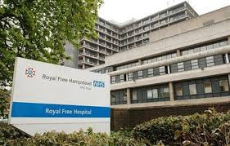
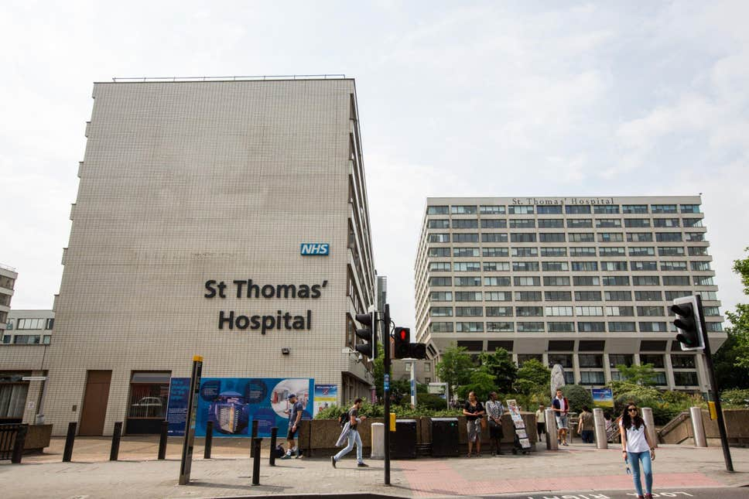
Why stroke?
Personal interest – PhD (Sociology of Medicine) studied social consequences of stroke – 1990s
Interested to find out why scientists working with stroke animal models persist despite poor success
Clinical translation acknowledged to be a problem – 0.1% success rate (Howells et al 2012)
An anomaly for field of translational research
Notes:
In context
Alzheimers: 0.4% success rate (Cummings et al 2014)
Cancer: 5-8% success (Kola and Landis 2004; Mak et al 2014)
Cardiovascular: 20% success (Vatner 2016)
When anomalies accumulate within a paradigm Kuhn (1962) – historian of science – notes that we may be entering a period of revolutionary science – i.e. uncertainty about the paradigm and how long it will survive.

Slide 4
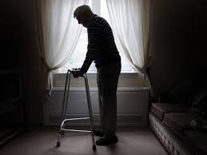
Stroke
Occurs when blood supply to brain becomes blocked, through clot or haemorrhage
Physical disability
Cognitive
Psychological
Social
Leading cause of death/ disability worldwide
Huge economic impact
Enormous personal costs
Notes:
2nd leading cause of death worldwide
3rd leading cause of disability worldwide
Economic burdens enormous: in England, Wales and Northern Ireland the total cost of health and social care for patients with acute stroke each year is estimated to be £3.6 billion - mean per patient cost £46,039 - (in the first five years following admission)

Slide 5
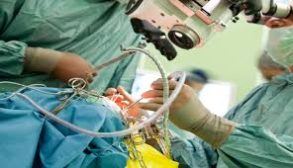
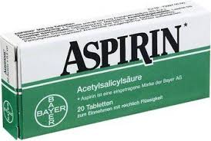
Notes:
Some (about 10-12%) will be eligible for restoring blood flow surgically (EVT: endovascular therapy). A small selected number of ischaemic stroke patients may also be eligible for decompressive craniectomy, to relieve pressure on the brain.
Best option for stroke patients is admission to a stroke unit, if they have one, which is a centre of expertise. Of all these treatments, stroke units are most effective in terms of avoiding death and dependency.
Secondary prevention is available for stroke patients who have had clots – in the form of aspirin.

Slide 6
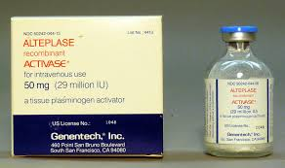
Unmet need in acute stages of stroke
Few pharmaceutical options for patients with acute stroke
Numerous drugs successful in animals but ineffective in humans
>1000 potential neuroprotective drugs (e.g. NXY-059, Nimodipine) tested in animals but not one benefits humans
Some successful in animals but increase mortality in humans (e.g. Diaspirin, Enlimobab, Selfotel, Tirilazad)
Only one drug for acute stroke : alteplase (thrombolytic)
went straight to clinical trials following success with heart attack
only 10-12% stroke patients eligible
half will remain dependent or die
Need treatments that will benefit more than just a minority of stroke patients

Slide 7
Research questions
How have researchers using animal models of stroke responded to problem of poor translation?
What do they attribute the translational problems to, and what solutions do they propose?
Is there evidence of a move away from animal models – and possibly toward more human focused methods - as a result of poor translation?

Slide 8
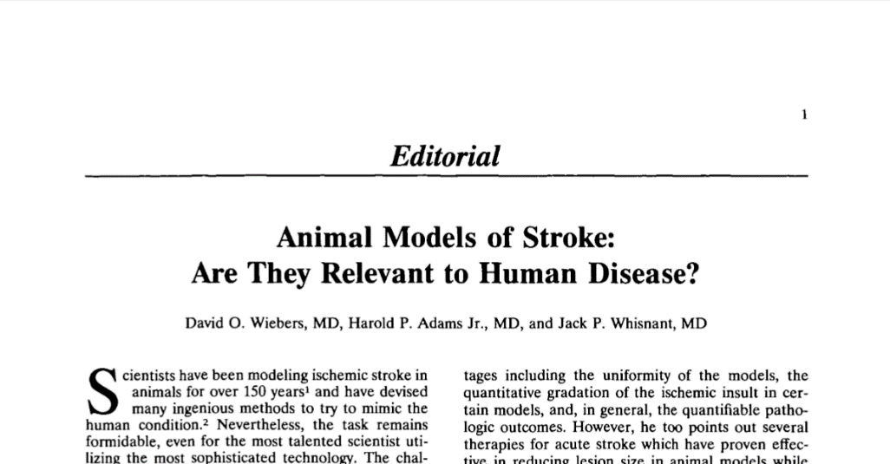
Research design: Analysis of published opinion papers
To provide insight into views of experts
What researchers are communicating to each other,
i.e. insider views, not for general public
Included papers
Commentaries/ editorials/ viewpoints/ special reports
About failure of animal models to translate into pharmaceutical drugs for acute stroke
By preclinical animal researchers/ clinical research scientists
Excluded papers
Narrow, specific or technical focus
No specific focus on stroke
Rehabilitation treatments/ surgery/ regenerative therapies
Primary research, systematic reviews, conference abstracts, letters
Notes:
Decided to analyse published opinion papers. Better than survey as views are unfiltered – from one scientist to another – not for general consumption.
Also quicker and easier
Regenerative therapy: not acute, not pharmaceutical. Stem cells transplanted into brains to encourage neural cells to regenerate. Almost 4 decades of laboratory research have shown safety and efficacy of stem cells in stroke animals.
Two recently concluded clinical trials indicated stem cells are safe but not effective in stroke patients.

Slide 9
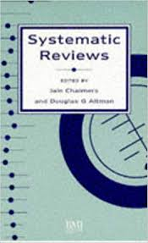
Synthesising opinions
Synthesis of opinions allows us to:
explore discourse around animal models of stroke
gain insight into views and debates occurring, direction of travel
Systematic approach to literature searching and data extraction
Not generating new data as a result of synthesising primary research evidence
Notes:
Additionally, because the papers are not reporting research there is no need to conduct quality appraisals

Slide 10
Searching for the literature
References obtained from HAND-SEARCHES n = 57
References obtained from ELECTRONIC SEARCHES n = 433
Double screening
Double screening on title and abstract
Excluded n = 1
Included n = 56
Included n = 104
Excluded n = 329
Exclusions during data extraction n = 2
Further double screening to select papers to read in full
Journals ‘Stroke’ & ‘Translational Stroke Research’
Camarades Website
Serendipity
Reference checking
Included n = 30
Excluded n = 74
Included n = 54
After reading full papers
Medline
Embase
Web of Science
Total included papers n = 80
Included n = 26
Excluded n = 4

Slide 11
Data extraction and analysis
Papers analysed chronologically
Data relevant to the research questions extracted
Analysis guided by research questions, but allowed for unexpected themes to emerge too
Notes:
Qualitative analysis:
Deductive - analysis guided by research question
Inductive - allowing additional / unexpected themes to emerge

Slide 12
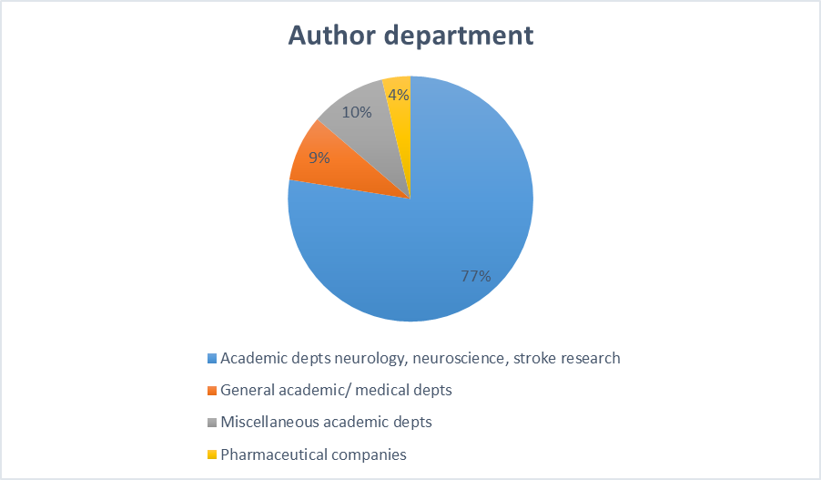
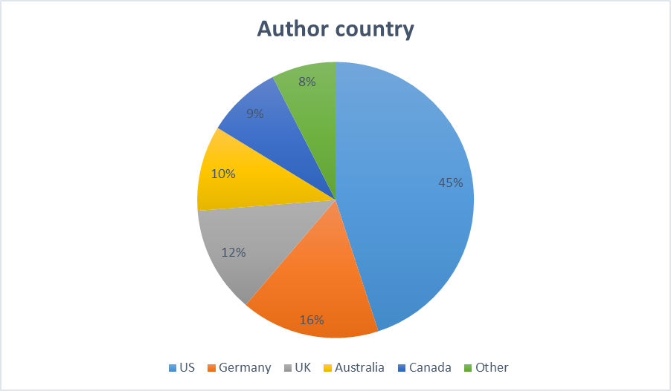
Notes:
Over 80% of papers published in the last two decades

Slide 13
Q1. How have researchers using animal models of stroke responded to the poor ability of these models to clinically translate?
13/80 papers made general observations about the state of preclinical translation:
1988: Interventions that worked in animals in 1970s have failed to translate clinically; this challenges legitimacy of using animal models for stroke (Hsu 1988)
1990: Overreliance on animal models will impede rather than advance progress in treating stroke (Wiebers et al 1990)
1988/ 1992: Overselling ‘promising’ results of animal studies will lead to launch of expensive, but ultimately disappointing, clinical trials (Molinari 1988, Millikan 1992)
2005: Advances that had occurred in stroke medicine had been without the use of animal models (Kaste 2005; Donnan and Davis 2005)

Slide 14
Contd. …
2013: Animal models of stroke have been available for over 50 years but few advances in clinical treatment of acute stroke have occurred (Greenberg 2013)
2014: Widespread doubt now exists about validity of using animal models as predictive tools in stroke (Herson and Traystman 2014)
2016/17: Bench-to-bedside translation in stroke has a ‘disappointing track record’. Neuroprotection in particular has been a ‘spectacular’ failure (Boltze and Ayata 2016; Neuhaus et al 2017)
2016/17: Stroke incidence, morbidity and mortality have decreased but this not due to ‘bench-to bedside’ translation.’ (Dirnagl 2016; Zerna et al 2017)
2016/17: More than 90% of acute stroke patients still lack treatment to limit injury/ improve outcome (Boltze and Ayata 2016; Zerna et al 2017)

Slide 15
Q.2 What do authors attribute translational problems to? What solutions do they propose?
Notes:
I am interested in extent to which explanations challenge or conform to the animal model paradigm

Slide 16
Notes:
Note that numbers on the chart refer to the number of papers that mentioned an issue
Most of the causes suggested by researchers were classified as problems of external validity, followed by problems of internal validity
Problems of external validity include things such as inability of the animal model to accurately represent human stroke, lack of representativeness of animal samples (i.e. young, fit animals, no comorbidities)
Problems of internal validity include poor experimental design, lack of measures to reduce risk of bias, small sample sizes etc
Problems with clinical trials include long window between stroke and administering experimental drug (whereas in animal studies the drug is administered very quickly after the stroke is induced)
Lack of proof of principle: e.g. do neuroprotectants actually reach the target tissue (ischaemic penumbra)/ do drugs cross the blood- brain barrier?

Slide 17
Notes:
Greater scrutiny of animal studies - by journal editors, reviewers and those planning clinical trials, together with systematic reviews and audits of animal studies

Slide 18
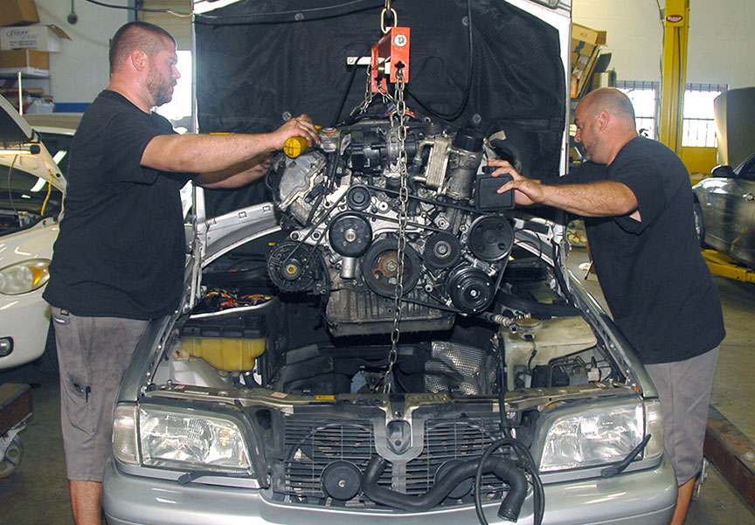
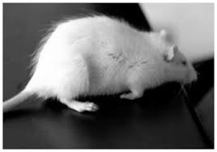
Disagreement about whether improvements will increase clinical translation
Guidelines have failed to improve translation
Failure of NXY-059 - developed according to the best preclinical and clinical guidelines
Animal models may be too dissimilar to human stroke
Translational stroke research not broken, ‘its engine simply needs overhauling’ (Dirnagl 2016)
Improvements in scientific quality of preclinical studies & in clinical trial design will lead to successful translation
Notes:
Stair guidelines first published in 1999 and updated in 2009
NXY-059 is a neuroprotective drug

Slide 19
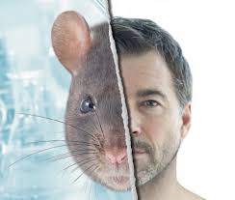
22 authors raised concern about animal-human species differences
Anatomy, physiology and disease manifestation
Pharmacokinetics and treatment response
Immune response
Genetics
These fundamentally challenge animal model paradigm?
Notes:
Anatomy, physiology and disease manifestation
e.g. rodents have small smooth brains, humans have large brains with multiple folds of the cortical surface
Pharmacokinetics and treatment response
i.e. species variations in way drugs work, dosage, side effects, efficacy
Immune response
e.g. rodents and humans have different inflammatory and immune responses to stroke
Genetics
Despite genetic similarities in mice and humans, the generation of proteins from these genes differs significantly, indicating important differences in how human and rodent cells respond to stroke

Slide 20
How to address animal-human species differences?
Solutions proposed by 16/ 22
Develop animal models that replicate human stroke more faithfully
Test in NHPs or unspecified ‘larger animal models’
Test in specific animal species, or 2 different animal species
Focus on similarities
Notes:
Some authors suggested more than one solution

Slide 21
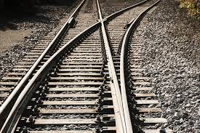
How to address animal-human species differences?
Solutions proposed by 3 /22
Reject animal model paradigm: abandon efforts to perfect animal models - focus on approaches based on human biology (Wiebers et al 1990)
Bridge paradigms: use in vitro methods alongside animal models - well established in vitro models exist, in vitro testing cheaper (Donnan 2008; Antonic et al 2012)

Slide 22
Q.3. Is there evidence of a move away from animal models – and possibly toward human focused methods - as a result of poor translation?

Slide 23
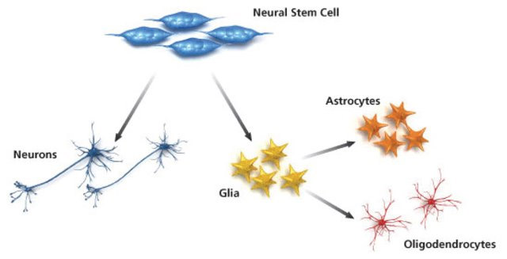
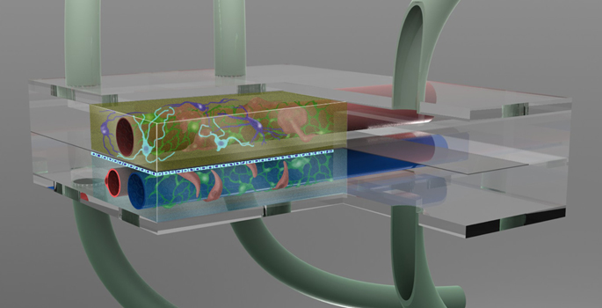
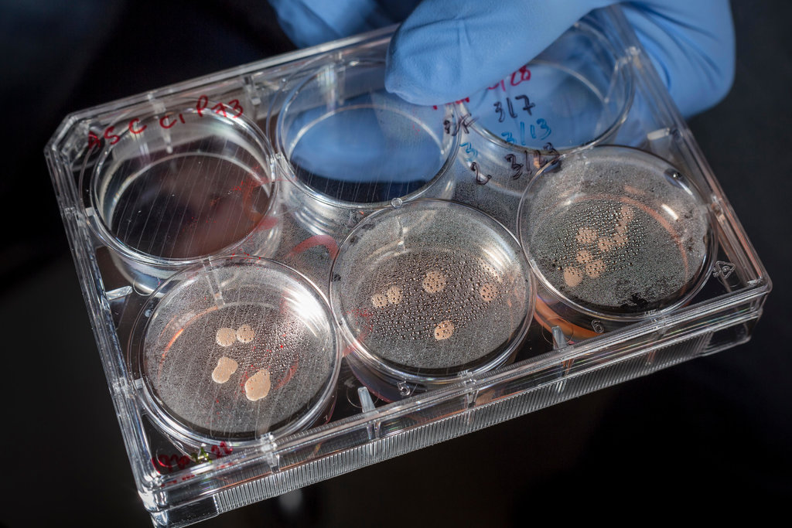
Paradigm bridging
In total 8 papers suggested using in vitro and in vivo approaches together
Authors highlighted increased availability of human cell lines, tissues, organoids, iPSC technologies etc, and benefits:
Enable proof of concept studies in humans before clinical trials
Can exclude ¼ drugs from further development
Offer mechanistic insight into potential drugs
Demonstrate impact of oxygen & glucose deprivation on specific cell types
Provide valuable ‘target validation’ at molecular level
Affordable

Slide 24
Recap
Authors agree that translational stroke research is at a critical point
Most explanations for poor translation did not fundamentally challenge use of animal models
Most solutions involved improving quality of animal studies/ animal models, although authors disagreed about whether this would increase clinical translation
8 authors proposed using human in vitro methods alongside animal models; 1 proposed using only human focused methods

Slide 25
Why continued commitment to animal models?
Psychological lock-in (Frank 2005)
Ethical challenges to animal research may harden researchers’ belief in value of work
Closed nature of animal research: lack of exposure to other disciplines/ academic opinions - beliefs become entrenched
Institutional lock-in
Infrastructure that perpetuates animal research within universities, e.g. funding streams
Notes:
Invested in idea that animal research ‘works’, i.e. benefits humans, hard to keep an open mind on issue
Other examples of institutional lock in – career pathways, ease of publication etc.

Slide 26
Why continued commitment to animal models?
Failure to translate - significant anomaly for a field of translational research
Kuhn (1962)
When confronted with anomalies within a paradigm, scientists do not renounce paradigm but attempt to modify theories/ experimental techniques
A paradigm will only break down in response to the appearance of deep (not superficial) problems that reveal real inadequacy in the paradigm
View that problems are superficial/ i.e. improvements in scientific rigour will increase translation
Notes:
Thomas Kuhn – a historian of science - provides another way of looking at the issue
A scientific anomaly is something that deviates from what is expected
[Debate on fundamental issues
Kuhn notes that scientists doing normal science generally agree on the fundamentals – they don’t waste their time arguing about the most basic issues arising in a field. Kuhn felt that unless debate about fundamentals was closed off, the efficiency of science would be reduced. ]

Slide 27
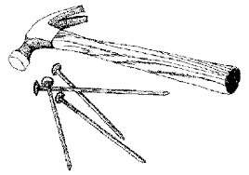
Why not more interest in human focused approaches?
Kuhn (1962)
A paradigm is an entire scientific outlook- shared assumptions, beliefs, values – uniting a scientific community and allowing science to take place
may blind scientists to other ways of conceptualising problems
Scientists tend to select problems that can be solved with theories and instruments close to those that already exist, rather than pursuing new phenomena / theories

Slide 28
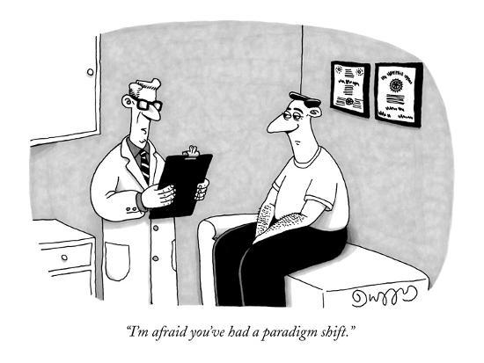
Why not more interest in human focused approaches?
Kuhn (1962)
Even if a paradigm has gone badly astray, it will only be declared invalid if an alternate paradigm is available to take its place
A new paradigm will need to solve one or more of the problems that prompted the crisis in the old paradigm
Human focused /in vitro approaches need to be valid, reliable and fit for purpose
Lack of confidence in in vitro approaches – studies of preclinical in vitro models considered ‘even worse than animal studies’ (RoB etc.)

Slide 29
Concluding thoughts
Kuhn (1962)
Scientists shouldn’t drop paradigm every time problems arise
ideas need time/ protection to develop
too much willingness to revise basic beliefs makes science chaotic
Lakatos (1970)
Acceptable to protect struggling research programmes for a while - in case they recover - but high risk
How long is it reasonable to wait for a paradigm to prove itself?
Laudan (1977)
It is rational to pursue the research tradition that has the highest level of problem-solving power
Notes:
[Lakatos in: Lakatos and Musgrave 1970: Criticism and the growth of knowledge
A progressive research programme is one that succeeds in increasing its predictive power
A degenerating research programme only addresses existing problems, i.e. is not being successfully extended to new cases]

Slide 30
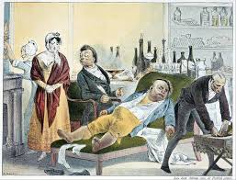
Conclusions
Continued strong commitment to stroke animal models despite frank acknowledgement of shortcomings
Some evidence of another paradigm emerging in form of in vitro/ human-focused approaches
‘Paradigm bridging’ a first step towards wider transition?
Continuing unmet need suggests we should explore validity of other approaches?
Notes:
Not a great deal has moved on for the majority of stroke patients, since I worked in the field in the 1990s – and I feel, for the sake of stroke patients, we have a duty to explore the possibility and validity of other approaches.

Slide 31
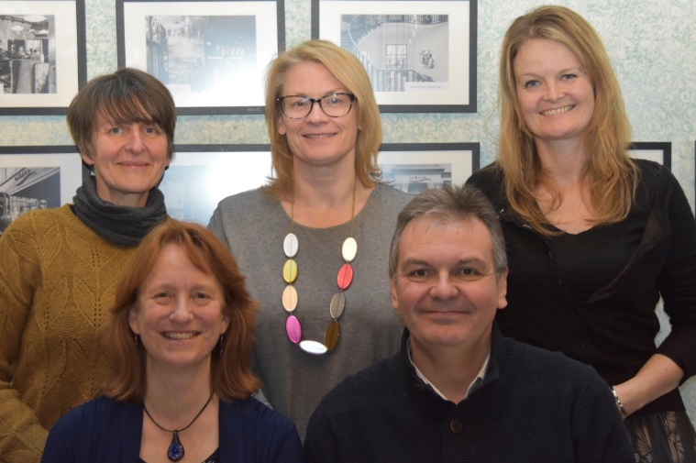
Acknowledgements
Colleagues at Safer Medicines Trust, especially
Rebecca Ram
pandora@safermedicines.org

