Slide 1
Overcoming obstacles to human relevant science
Gerry Kenna
Safer Medicines Trust
gerry@safermedicines.org

Slide 2
Outline of presentation
Where we are right now
Where we need to be
Obstacles hindering change
How can we overcome the obstacles?
Conclusions

Slide 3
Where we are right now
Animal procedures are used routinely to study disease mechanisms, discover and develop new drugs and evaluate drug safety
  Generally considered the “Gold Standard”
  Often required by regulatory agencies and science funders
But many animal procedures have limited human relevance….
Useful human-relevant non-animal methods have been described and are being developed
It is widely accepted that animal procedures should only be undertaken according to 3Rs principles (i.e. where there are no valid alternatives)
  How to identify and stop using ineffective animal procedures?
  How to accept/validate/use effective human-relevant non animal methods?

Slide 4
Animal studies do not predict human CNS effects of drugs
Central Nervous System (CNS)-related safety concerns are major contributors to delays and failure during development of new candidate drugs (CDs).
The animal-human concordance between CNS-related safety data on 141 small molecule CDs from five pharmaceutical companies was assessed
  rodent multi-parameter neurofunctional assessments (Functional Observational Battery: FOB, or Irwin test: IT)
  the five most common adverse events (AEs) in Phase I clinical trials: headache, nausea, dizziness, fatigue/somnolence and pain.
The FOB/IT did not predict the occurrence of these particular AEs in man.
Conclusions from: Assessing the predictive value of the rodent neurofunctional assessment for commonly reported adverse events in phase I clinical trials.Regul Toxicol Pharmacol. 2016, 80:348-57.

Slide 5
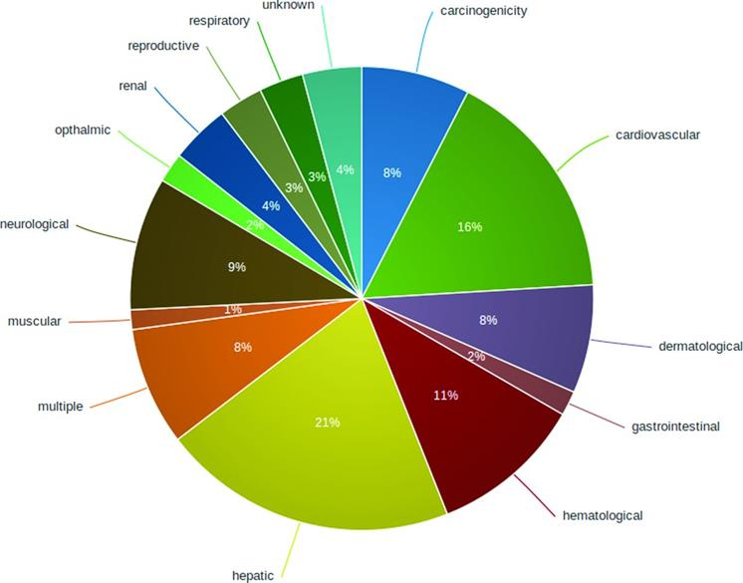
Animal studies do not predict human neurotoxicity of drugs
A database of 578 withdrawn or discontinued drugs, their structures, important physico-chemical properties, protein targets and relevant signaling pathways.
Safety issues were the main reason for withdrawal of approx 50% of the drugs.
From: WITHDRAWN—a resource for withdrawn and discontinued drugs
Nucleic Acids Research 2016, 44, Issue D1, D1080–D1086.

Slide 6
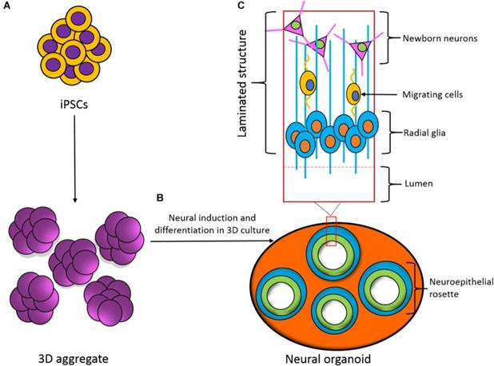
In vitro human neural cell models
FIGURE 3
Development of a three-dimensional (3D) neural organoid from IPSCs.
(A) IPSCs can be spontaneously differentiated within 3D aggregates.
(B) 3D aggregates can be further cultured in 3D to develop a neural organoid. These neural organoids recapitulate the developmental processes and structural hierarchy seen in the developing brain.
(C) Section of the laminated structure formed within the neural organoid.
From: In vitro Models for Seizure-Liability Testing Using Induced Pluripotent Stem Cells Front Neurosci. 2018; 12: 590.

Slide 7
Where we need to be
Human relevant non-animal methods enable:
  accurate and effective investigation of human diseases and human toxicities
  reliable decision making within industries developing new treatments for diseases, plus regulatory agencies
Regulatory guidelines require use of human-relevant methods, not animal procedures
Scientific researchers and funding agencies focus on use and optimisation of human relevant methods

Slide 8
Obstacles hindering change
Much of our current understanding of in vivo biology and physiology came from in vivo investigations undertaken in animals and humans
Human diseases and toxicities are complex – there is a lot we still don’t know
Which in vitro models, how to use them?
Many scientists are quite conservative – “we know what we know”
Regulatory agencies need to be risk-averse
It’s usually much easier to criticise than to innovate.

Slide 9
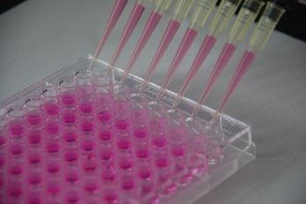
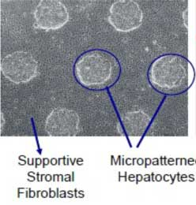
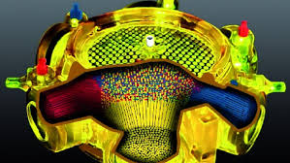
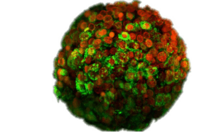
Many possible in vitro models
Low
High
Simple
Intermediate
Complex
Cultured liver cell lines
Membrane vesicles
Complexity
Cost
Volume
Turnaround time
Bioreactors
Spheroids
High
Low

Slide 10
Which in vitro models?
  Mechanistic relevance?
  Robustness, throughput, turnaround time, cost?
Which endpoints?
How to interpret the data the assays provide?
  How to evaluate and validate them?

Slide 11
How can we overcome the obstacles?
Set achievable “bite size” goals
Select in vitro models that provide insight into human-relevant in vivo mechanisms
Validate human-relevant in vitro assays vs. in vivo human outcomes, not animal data

Slide 12
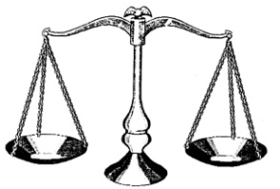
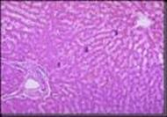
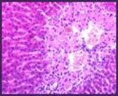


How drugs cause liver toxicity
Drug
Compound related effects
Can be explored using simplified “in vitro” model systems
Step 1
Drug ADME
Step 2
Chemical insult to target cells
Step 3
Biological response in cell
Patient related effects
Can be explored only in vivo
Step 4
Biological response in tissue
Protection
e.g. stress response
Propagation and amplification
e.g. innate and adaptive immunity
Outcome
Liver Toxicity
No toxicity:
tolerance &
adaptation
Preclinical species vs. man

Slide 13
Multiple liver toxicity mechanisms require multiple in vitro assays
Chemical insult | Assay
Cell cytotoxicity | THLE-Null cell toxicity
Reactive metabolite toxicity | THLE-3A4 cell toxicity
 | Covalent binding to human hepatocyte proteins
Mitochondrial injury | HepG2 cell toxicity in glucose vs. galactose media
 | Seahorse® analyzer
Membrane transporter inhibition | Bile Salt Export Pump (BSEP) inhibition

Slide 14
For technical detail of the assays, how their performance was evaluated, and how data from multiple assays was combined, see:
  Chem. Res. Toxicol. 2012: 25;1616
  Drug Metab Dispos 2012; 40:130
  Toxicol Sci 2014;137:189

Slide 15
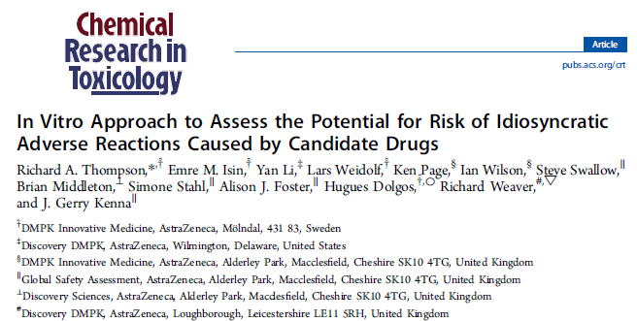
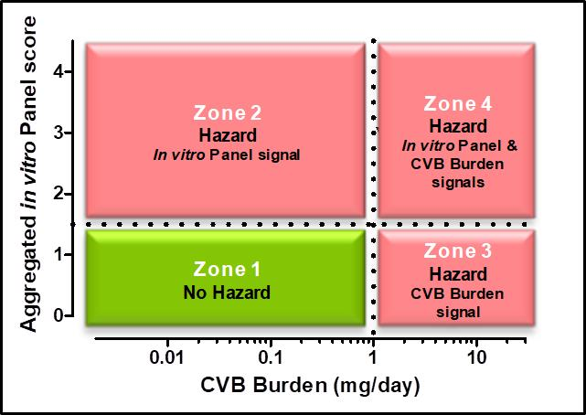
Chem Res Toxicol 2012; 25:1616.
CVB burden is a way to quantify reactive metabolite formation
Excellent discrimination between 27 toxic drugs and 9 non-toxic drugs (100% sensitivity, 78% specificity)

Slide 16
Endothelin receptor antagonists
Drug | Dose, mg/day | Number of patients treated | Human DILI observed | Status
Sitaxentan -Thelin® | 100 | 2,000 | 4 deaths 1 liver transplantation | Withdrawn 2010
Bosentan -Tracleer® | 250 | 80,000 | Elevated LFT common Cases of severe liver injury | Black box warning
Ambrisentan -Letairis™ (US), -Volibris® (EU) | 10 | 10,000 | None, but precautionary label when licensed | Safe drug, no DILI label
Galie et al. 2011, Eur. Respir. J. 37:475

Slide 17
JPET #220491
Multiple compound related adverse properties contribute to liver injury caused by endothelin receptor antagonists
J. Gerry Kenna, Simone H. Stahl, Julie A. Eakins, Alison J. Foster, Linda C. Andersson, Jonas
Bergare, Martin Billger, Marie Elebring, Charles S. Elmore, Richard A. Thompson
This article has not been copyedited and formatted. The final version may differ from this version.
JPET Fast Forward. Published on December 2, 2014 as DOI: 10.1124/jpet.114.220491
J Pharmacol Exp Ther. 2015 Feb;352(2):281-90
Human in vivo drug exposure was considered when interpreting the in vitro assay data.
Multiple in vitro liabilities were identified for sitaxentan (mito tox, BSEP inhibition, reactive metaboites) and bosentan (BSEP inhibition, reactive metaboites).
The results correctly predicted that sitaxentan and bosentan would cause liver injury, while ambrisentan was safe.
None of the drugs caused liver injury in animals.

Slide 18
Lessons learned from our in vitro liver toxicity studies
Mechanistically relevant in vitro assays discriminated between drugs that cause human liver injury and “safe” drugs much more accurately than animal safety studies.
  Multiple assays were needed, since liver injury can be caused in multiple ways.
  Data interpretation needed to take account of in vitro assay potency and also drug exposure in vivo.
  Data from multiple assays could be integrated using a Hazard Matrix.
The in vitro assays did not address patient-specific susceptibility factors, so were unable to predict whether or not liver injury might arise in individual humans.

Slide 19

How the in vitro assays can be used
  A tool which enables design and selection of safe compounds in drug discovery, when there is chemical choice

Slide 20
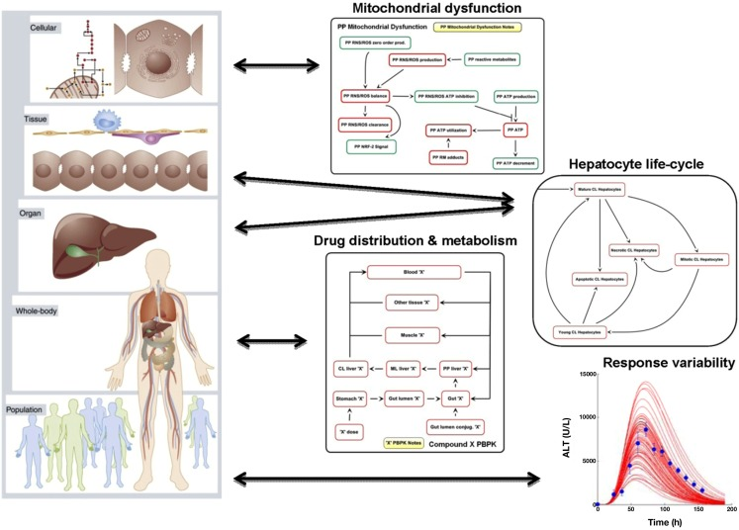
Pharmacokinetic Exposure Modelling
e.g. Hamner DILI-sim consortium: http://www.dilisym.com/
Simulations of human population variability in tissue exposure to drugs is used when interpreting in vitro toxicity data

Slide 21
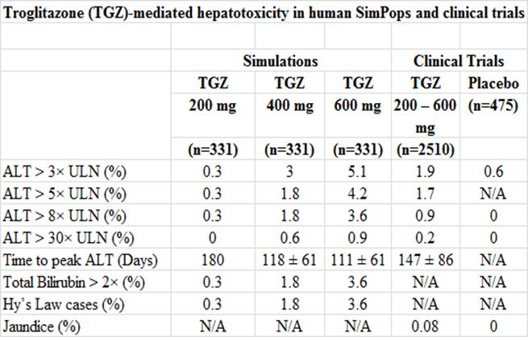
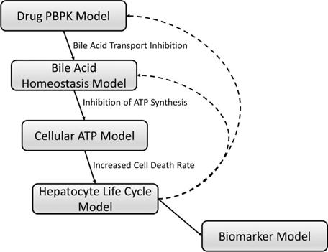
From: Clin Pharmacol Ther (2014) 96(5):589-598
Prediction of human drug induced liver injury from in vitro data
Drug exposure-based analysis of in vitro human liver toxicity data accurately predicted the frequency of liver injury observed in vivo in human clinical trials

Slide 22
How can we overcome the obstacles?
Use Adverse Outcome Pathways to validate selection of in vitro assays and endpoints
Align in vitro human relevant assays with in vivo biomarkers
  Chemical (blood)
  Imaging

Slide 23
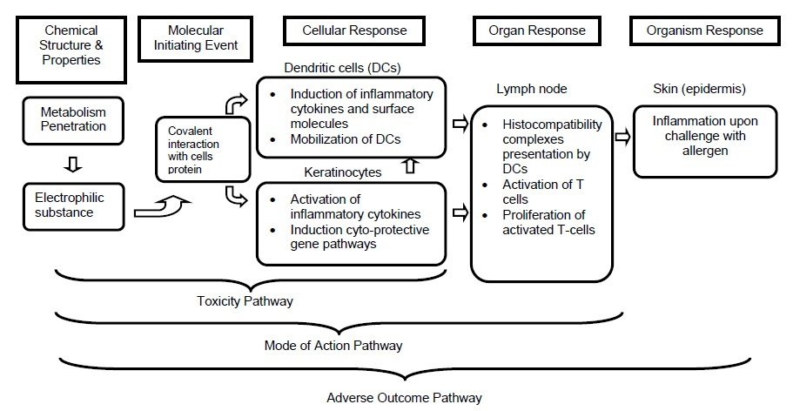
The future: Adverse Outcome Pathways
OECD. (2012). The Adverse Outcome Pathway for Skin Sensitisation Initiated by Covalent Binding to Proteins Part 1: Scientific Evidence. [Series on Testing and Assessment No.168 ENV/JM/MONO(2012)10/PART1].

Slide 24
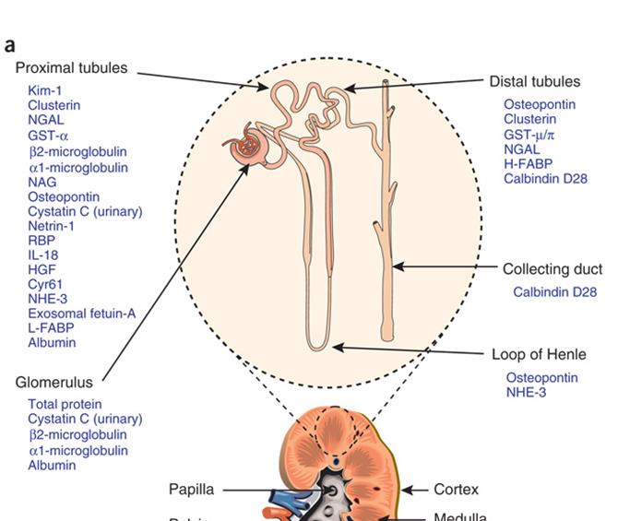
Novel blood organ toxicity biomarkers
From: Next-generation biomarkers for detecting kidney toxicity
Nat Biotechnol. 2010 May; 28(5): 436–440.

Slide 25


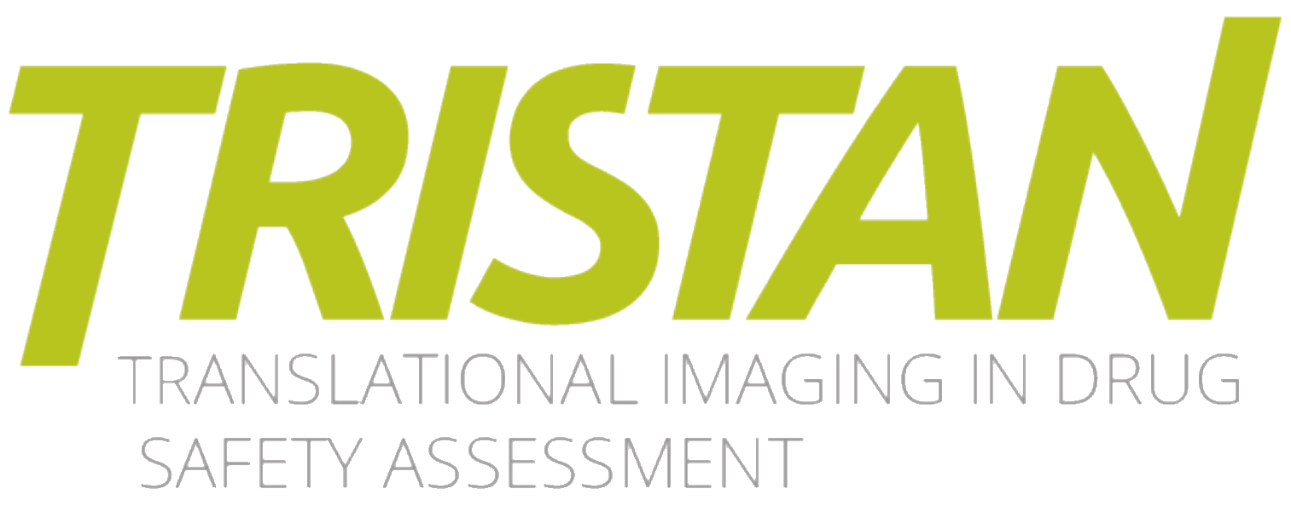
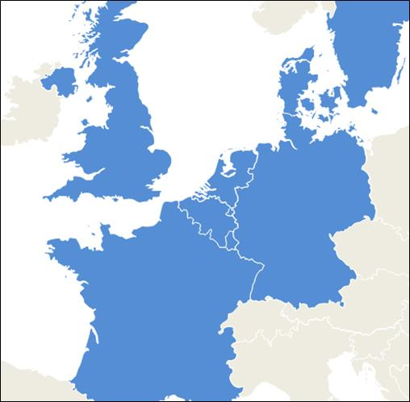

TRanslational Imaging in Drug
SafeTy AssessmeNt
International non-profit
organisation:
EORTC (Coordinator)
Pharma:
Abbvie
Bayer (Lead)
GSK (Co-lead)
Merck / MSD
Novo Nordisk
Pfizer
Sanofi
Imaging Vendor:
Bruker
GE Healthcare
SME:
Antaros
Bioxydyn
Truly
University:
Chalmers
Dijon
Groningen
Leeds
Lund
Manchester
Nijmegen
Sheffield
Chalmers
Lund
Manchester
NovoNordisk
Truly
Bioxydyn
Sheffield
Groningen
GE
GSK
Nijmegen
Bayer
EORTC
Sanofi
AbbVie
Bruker
US based:
Dijon
Pfizer
MSD
A consortim funded by the EU/EFPIA Innovative Medicines Initiative
Combines expertise in toxicology, pre-clinical and clinical imaging as well as animal models and radiochemistry

Slide 26
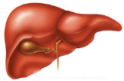
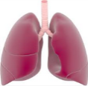
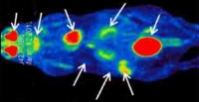

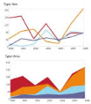

Overall TRISTAN Scope
Leverage the potential of imaging techniques to improve drug safety analysis and translatability of findings from animals to humans by
  technically, biologically and clinically validating imaging procedures as biomarkers.
The scope will be specifically addressed in 3 key areas identified as most urgent:
  Liver-bile transporter assessment
  Pulmonary toxicity assessment
  Bio-distribution of biologics
  Standardization and validation of image
  acquisition, evaluation & reporting
For more information: https://www.imi-tristan.eu/

Slide 27
How can we overcome the obstacles?
Engage with and influence scientists - they are our partners, not our enemies
  Scientific experts in industry and academic research labs
  Funders
  Regulatory agencies
Work collaboratively
Inform and educate non-specialist scientists, non-scientists, politicians and the general public

Slide 28
Safer Medicines Trust
An independent charity.
Our goal is to replace poorly performing animal studies with more predictive human biology-based methods, for human efficacy and safety testing of pharmaceuticals and other chemicals.
See: www.SaferMedicines.org

Slide 29
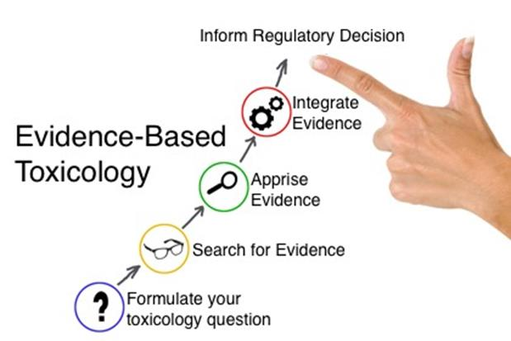
Evidence Based Toxicology Collaboration (EBTC)
A collaboration of science, regulatory and industry leaders, united in their vision to improve the public health outcomes and reduce human impact on the environment by bringing evidence-based approaches to safety sciences.
See: www.ebtox.org/

Slide 30
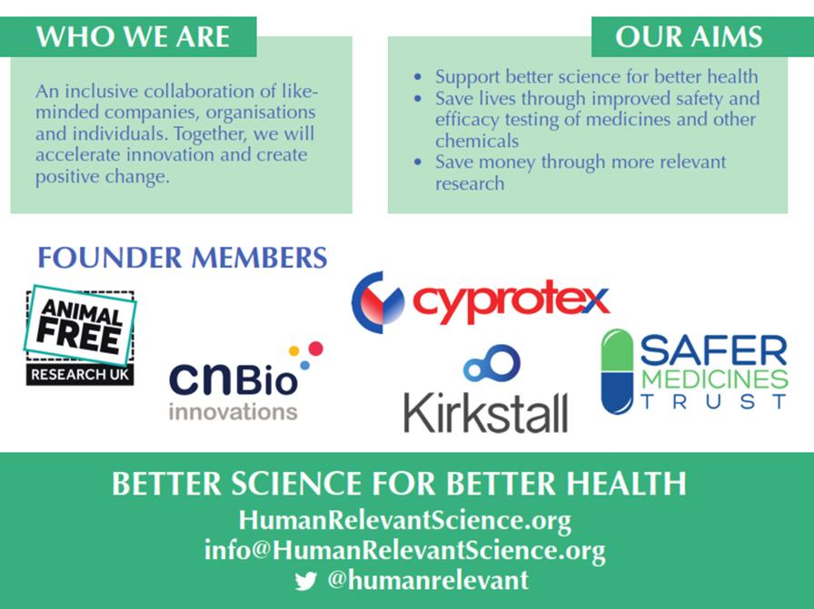
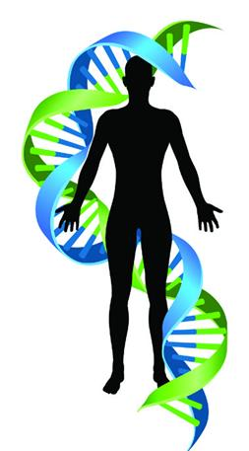
Alliance for Human Relevant Science

Slide 31
Conclusions
Human relevant methods are needed to detect human toxicities caused by drugs that cannot be predicted from animal studies.
In vitro methods that can detect human drug induced liver injury toxicities with good accuracy have been described.
  Data interpretation must take account of in vivo drug exposure.
  In vitro assays must be mechanistically relevant.
  Relevant in vivo biomarkers are also needed.
More investment in in vitro assays and in vivo biomarkers is needed to enable them to be applied to neuroscience.
Although change is difficult, we can solve the problem by working together.
Once suitable methods are available, there will be no justification for animal procedures.

Slide 32
Thank you for listening.
Any questions?

