Slide 1
Towards a new ethics of animal research
Pandora Pound
Safer Medicines Trust
February 13th 2020

Slide 2
Plan of talk
Ethical context and regulations
Evidence about research quality and clinical translation
Response to evidence from ethicists and others – changing scientific landscape
Going forward

Slide 3
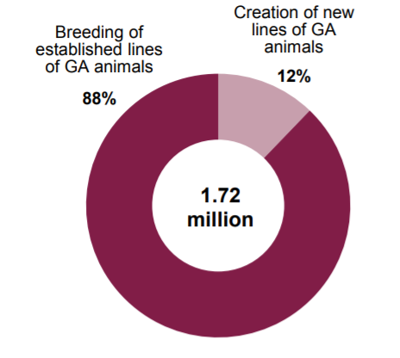
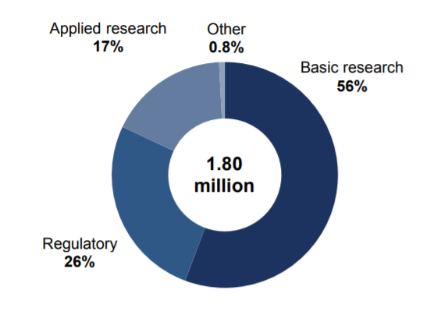
Uses of animals in research (UK)
3.52m procedures 2018
Creation/ breeding genetically altered animals (1.72m procedures)
Experimental procedures (1.8m procedures)

Slide 4
Part 1
Ethical context and regulations

Slide 5
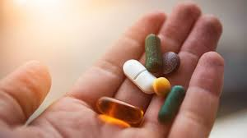
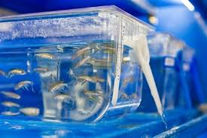
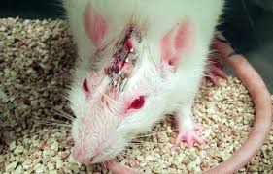
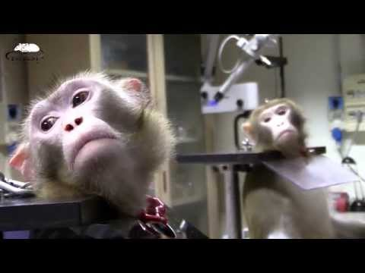
A necessary evil
‘Common sense’ view has been that animal research is something unpleasant we must accept in order to achieve benefits for humans
Focus will be on benefits

Slide 6
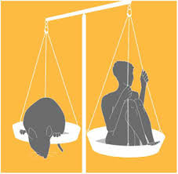
Ethical context
Humans count morally ‘more’ than animals, so animals can be harmed if the outcome is deemed to benefit humans
Utilitarian context - the end (benefits for humans) justifies the means (harms to animals)
Animals used in research for human treatments will not benefit in any way from the research
Animals do not consent to being research subjects and their vital interests are sacrificed for human interests

Slide 7
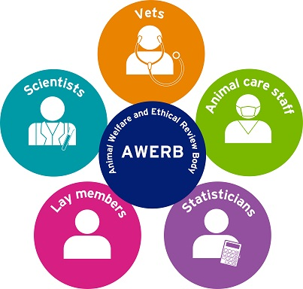
Steps involved in gaining approval for animal research
Animals in Science Regulation Unit (part of Home Office) considers licence applications
Idea for project
Secure funding
Submit project to institutional AWERB
Apply to Home Office for project licence
Weighing of harms & benefits of research (HBA)
Consideration of how to minimise harms (3Rs)

Slide 8
Harm benefit analysis (HBA)
HBA conducted by competent authority as part of licensing of animal studies (in UK since 1986, in Europe since 2013)
Cornerstone of regulation - involves weighing anticipated benefits of research against predicted harms to animals
‘to assess whether the harm to the animals in terms of suffering, pain and distress is justified by the expected outcome’ and to consider whether the research ‘may ultimately benefit human beings, animals or the environment.’ (European Union Directive 2010/63/EU, Article 38)
No ethical input into drafting of HBA regulations

Slide 9
3Rs – to minimise negative consequences
Replacement: use of methods which avoid / replace animals
Animals should only be used for scientific purposes where a non-animal alternative is unavailable
(Directive 2010/63/EU on the protection of animals used for scientific purposes)
Reduction: use of methods that enable researchers to obtain comparable levels of information from fewer animals, or more information from same number
Refinement: use of methods that alleviate or minimize potential pain, suffering or distress
Drafted in 1959 by zoologist and microbiologist - no ethical input
3Rs embedded in national /international legislation and policies of organisations that fund / conduct animal research

Slide 10
Critiques of HBA
Issue of human benefit central to justification of animal research, but difficult to prospectively assess benefit
Scientists optimistic about the potential benefits of their research when submitting applications
Implicit confidence in animal research - benefits are assumed
Evidence from AWERBs reveals that discussions focus on harms, minimal discussion of benefits for humans

Slide 11
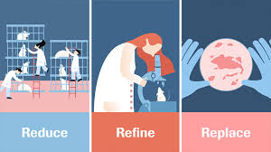
Critiques of 3Rs
Refinement
Refinement most commonly used R in practice, yet animals continue to suffer severe harms, (van Luijk et al 2013; Balcombe et al 2013; Pound and Nicol 2018)
Replacement
Uptake of non-animal techniques remains low
Reduction
Until 2018, no. animals used in labs increased annually
Can lead to small, statistically underpowered studies that are inconclusive (Cressey 2015) – animals ‘wasted’ so counterproductive
3Rs (Hobson-West 2009):
‘shorthand’ for ethics?– i.e. reassure that moral obligations to animals being considered?
brings about consensus in highly contested field

Slide 12
Part 2
Evidence about research quality and clinical translation

Slide 13
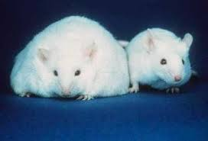
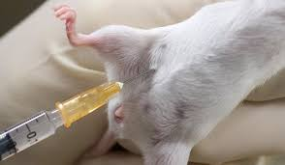
‘Animal models’
Animal ‘models’ - animals manipulated in various ways to make them mimic human disease
Aim is to avoid harming humans
e.g. obesity research: animal may be genetically altered, or fed high fat diet
Drugs then tested on ‘models’ and outcomes assessed

Slide 14
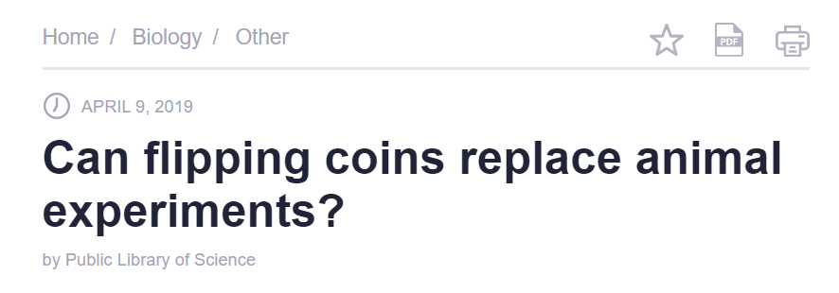
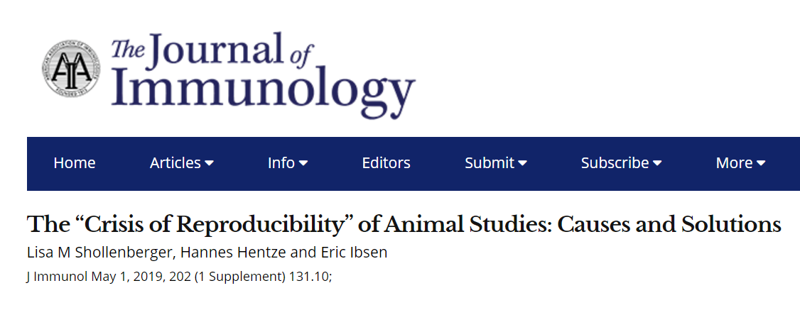
Reproducibility crisis
Animal research – as with other research fields – suffers from methodological problems / flaws that can render findings untrustworthy
Inadequate experimental design and other poor research practices
Issue of scientific quality inextricably bound to discussions about clinical benefit, so relevant to animal research ethics

Slide 15
Bias
e.g. publication bias in stroke means benefits of animal studies overstated by one third (Sena et al 2010)
All make animal studies appear more positive than they actually are (Scott et al 2008; Tsilidis et al 2013; Sena et al 2010; Holman et al 2016)
Systematic review evidence - few animal studies take steps to minimise risk of bias:
Random allocation to treatment/ control groups: 29%-37% (Hirst et al 2014; Henderson et al 2015)
Allocation concealment: 0 – 15% (Henderson et al 2015; Hirst et al 2014)
Blinding: 21% - 35% (Perel et al 2007; Hirst et al 2014)
Only 0.7% of animal studies reported a sample size calculation (Macleod et al 2015)
Failure to control for confounding variables, e.g. animal strain, sex, age/ diet, bedding, housing, method of dose administration, animal stress etc.
Reporting biases
Loss of animals from a study (e.g. through death) frequently poorly reported (Holman 2016)
Analyses with the ‘best’ results selected for publication (e.g. Cohen 2018)
Non publication of negative studies (Sena et al 2010)

Slide 16
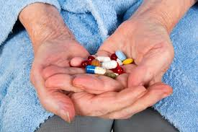
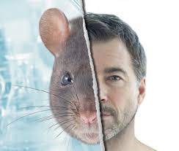
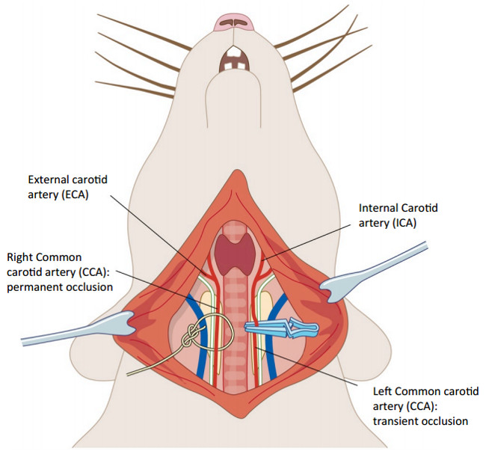
Problems with representativeness of animal models
Laboratory animals typically young - many human diseases manifest in older age
Animals typically healthy - many human diseases have comorbidity
Animals typically given only experimental drug
Most human diseases evolve over time – e.g. humans get stroke due to risk factors accumulating over lifetime, e.g. drinking, smoking, high BP
Evolutionary biology – mice may help re processes arising early in evolution but lineages leading to modern rodents / primates diverged 85m years ago
Animal models of stroke typically involve surgery to block the middle cerebral artery
Different diets, activity levels, microbiomes / immune systems, toxin /pathogen exposure
Less useful for understanding chronic, non-communicable diseases – causes enmeshed in human lifestyles

Slide 17
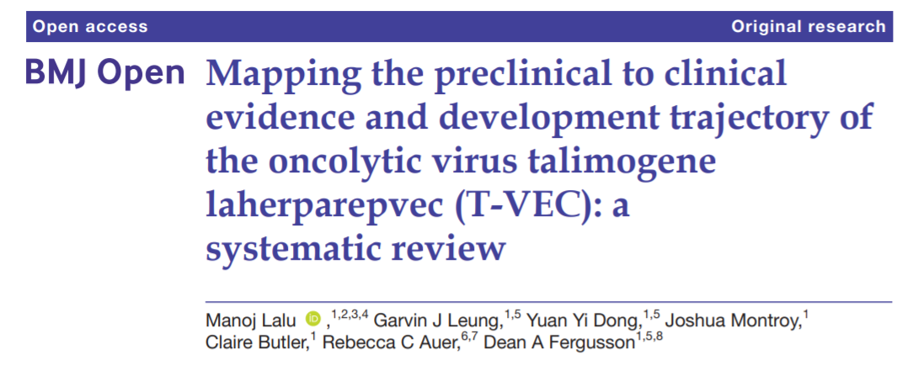
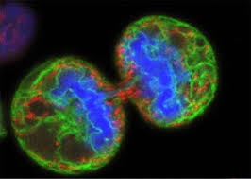
Implications for clinical translation?
Lalu et al observed large decreases in T-VEC’s efficacy as studies moved from animals to patients, and as studies became more methodologically rigorous
T-VEC - a treatment that uses a virus to infect and kill cancer cells
Results of animal studies appear positive – but once trialled in humans, results less positive

Slide 18
Concordance between animal and human studies – SR evidence
Intervention | Animal studies | Human studies | Concordance
Corticosteroids for head injury | Evidence of benefit | Evidence of harm | No
Antifibrinolytics for bleeding | Data inconclusive | Evidence of benefit | No
Thrombolysis for stroke | Evidence of benefit | (qualified) evidence of benefit | Yes
Tirilazad for stroke | Evidence of benefit | Evidence of harm | No
Antenatal corticosteroids for neonatal respiratory distress | Evidence of benefit | Evidence of benefit | Yes
Bisphosphonates for osteoporosis | Evidence of benefit | Evidence of benefit | Yes
Perel et al. Comparison of treatment effects between animal experiments and clinical trials: systematic review. BMJ 2007;334(7586):197.

Slide 19
Low rates for market approval of drugs
Positive animal studies lead to clinical trials - most unsuccessful - only 10% of experimental drugs make it from Phase I to approval (Thomas et al 2016)
Majority of failures due to inadequate efficacy and safety
Animal studies not only cause of high drug attrition rates, but widely acknowledged to play key role due to poor ability to predict human safety / efficacy (Innovate UK 2015; MDC Report 2018)

Slide 20
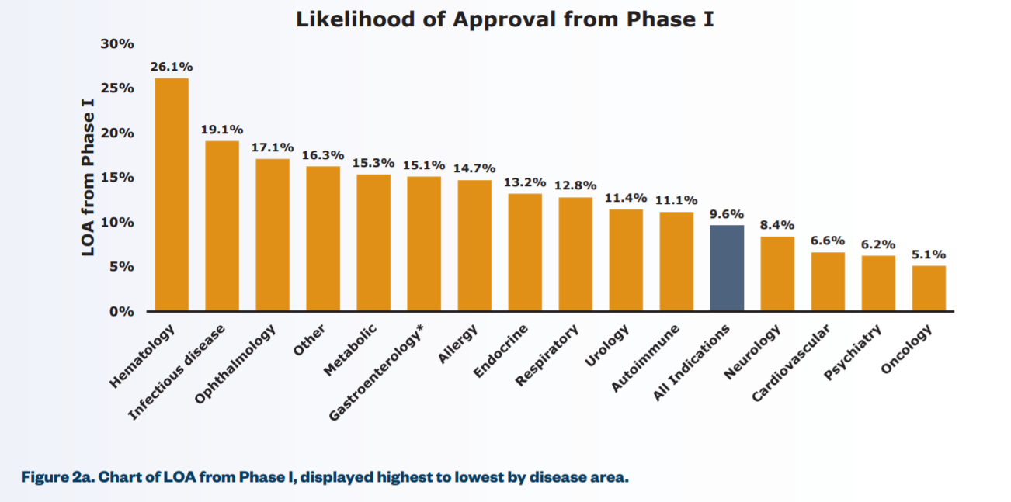
Unmet need
100s of human diseases for which no cures / treatment
Leading causes death (UK)
Cardiovascular: 6.6% drugs approved (Thomas et al 2016)
Cancer: 5% (Hutchinson & Kirk 2011; Mak et al 2014; Thomas et al 2016)
Alzheimers: 0.4% (Cummings et al 2014; Alteri & Guizzaro 2018)
Stroke: 0.1% (Howells et al 2012)
Thomas DW, Burns J, Audette J, Carroll A, Dow-Hygelund C, Hay M. 2016. Clinical Development Success Rates 2006-2015

Slide 21
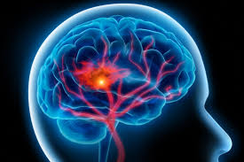
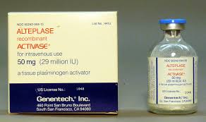
Stroke
Animal models of stroke since post WW2
e.g. 1026 potential neuroprotective drugs tested in animals – although many benefited animals, not one found to benefit humans (O’Collins et al 2006)
Some drugs successful in animals but increase risk of death in humans (Diaspirin, Enlimobab, Selfotel, Tirilazad)
Only 0.1% of all experimental drugs clinically tested gained market approval
Alteplase (‘clot-buster’)is only drug available for acute stroke
Alteplase went straight to clinical trials after success with heart attack, i.e. not dependent on animal studies for its development
Only 10-12% stroke patients eligible for alteplase and half of these die or remain dependent

Slide 22
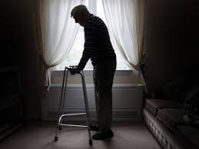
Unmet need
e.g. impact of stroke can be
Physical
Cognitive
Psychological
Social
Emotional
Leading cause of death/ disability worldwide
Huge economic impact
Enormous personal costs
Notes:
2nd leading cause of death worldwide
3rd leading cause of disability worldwide
Economic burdens enormous: in England, Wales and Northern Ireland the total cost of health and social care for patients with acute stroke each year is estimated to be £3.6 billion - mean per patient cost £46,039 - (in the first five years following admission)

Slide 23
Does animal research benefit humans?
Current poor quality of most animal research makes findings untrustworthy – biases make the body of animal research appear more positive than it actually is
‘Over-optimistic’ animal studies, as well as animal-human species differences, can lead to clinical trials with potential to harm humans
Most animal research aimed at developing drugs for human diseases fails
Even if animal studies were conducted perfectly, animal-human species differences would continue to make the extrapolation of findings from animals to humans unreliable

Slide 24
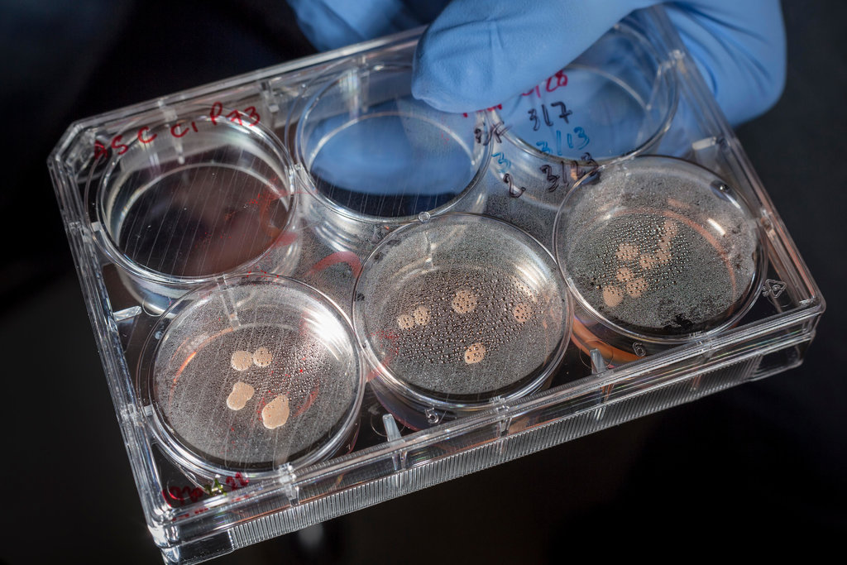
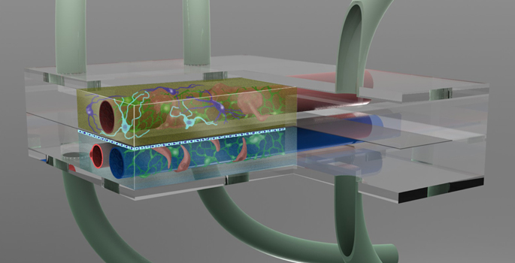
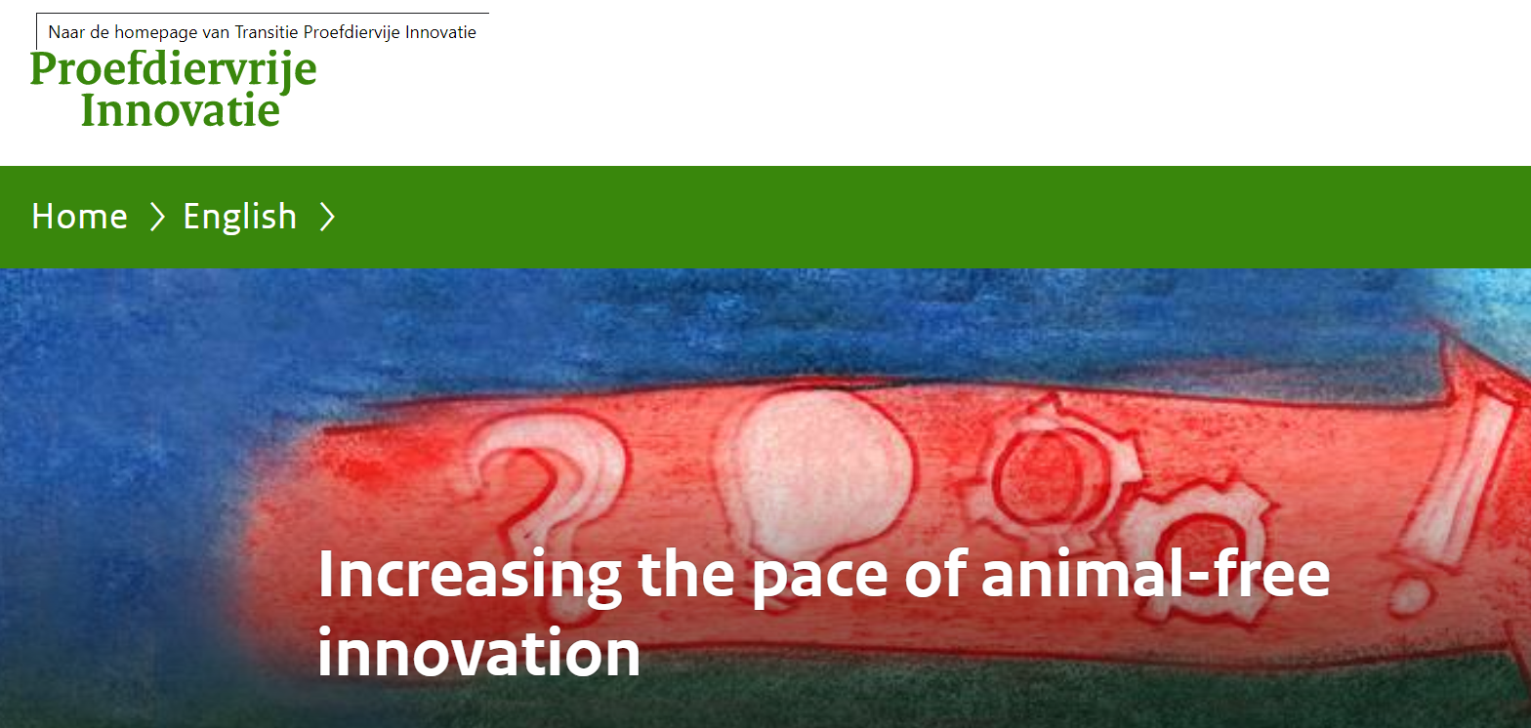
New approach methodologies (NAMs)
Advances this century in technologies and methods for studying human biology, disease and response to drugs without using animals – e.g. in vitro (tissue culture, organoids, organs-on-chips), in silico
In early stages, but promising – potentially more predictive than animals, could increase drug safety/ reduce ADRs
Excitement about potential of NAMs in some countries, e.g.
Dutch government aims to replace some animal research with NAMs by 2025
US EPA aims to replace research on mammals with NAMs by 2035

Slide 25
Human relevant research
Notes:
This short film focuses on organ on a chip technology and is from the Wyss Institute at Harvard, in USA

Slide 26
Part 3
Response to evidence from ethicists and others – changing scientific landscape

Slide 27
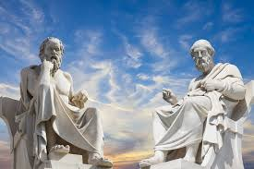
Responses to evidence – philosophers, public, animal protection organisations
An expectation of sufficient net benefit to humans must be a condition of morally responsible animal research (DeGrazia & Sebo 2015)
Proportion of UK public agreeing that use of animals for medical research is important to human health has fallen - from 46% (2016) to 41% (2018)
(Ipsos Mori 2018)
‘Since the best working hypothesis is that the human benefits of animal research are either small or unclear, we are not in a position to claim justification. If the benefits are small, they cannot outweigh large harms to animals; if they are unclear, even as to probabilities, then we do not know there to be any outweighing benefit.’ (Robert Bass 2012)
Advocate replacing animal research with human-relevant/ non-animal technologies
i.e. current situation not morally responsible, unethical

Slide 28
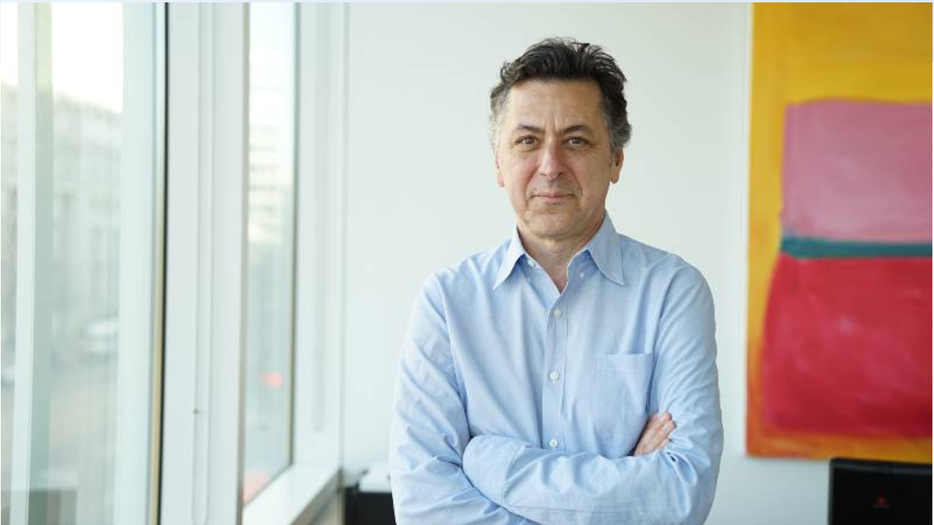
Responses to evidence – regulators
US regulator (FDA) requested long-term dog study
Vanda challenged request, stating dog studies would not inform human safety
FDA prevented Vanda proceeding to clinical trials
Vanda filed a lawsuit against FDA, charging them with ‘arbitrary and capricious behaviour’ in requiring dog studies
Dr Polymeropoulos, CEO of pharmaceutical company, Vanda
‘There is no evidence that long-term studies on dogs add any predictive value to human safety. The FDA is ignoring a large body of published scientific evidence that concludes these dog studies are uninformative. It is time to demand that the pharmaceutical industry and government regulators abandon unscientific, low-resolution animal testing and adopt modern, human-based scientific methods to advance human drug safety’.

Slide 29
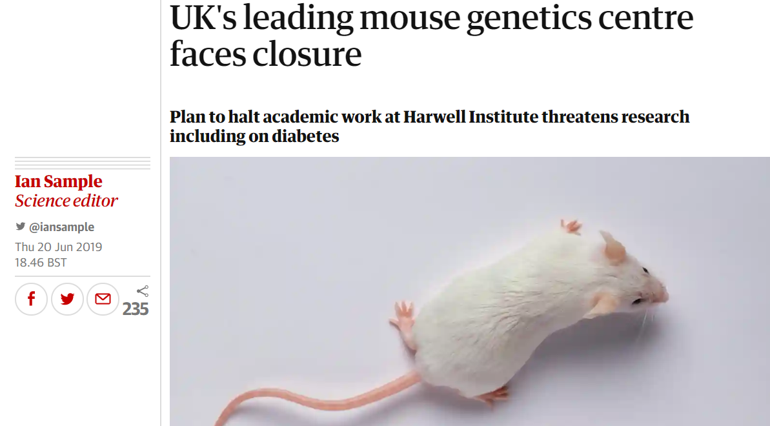
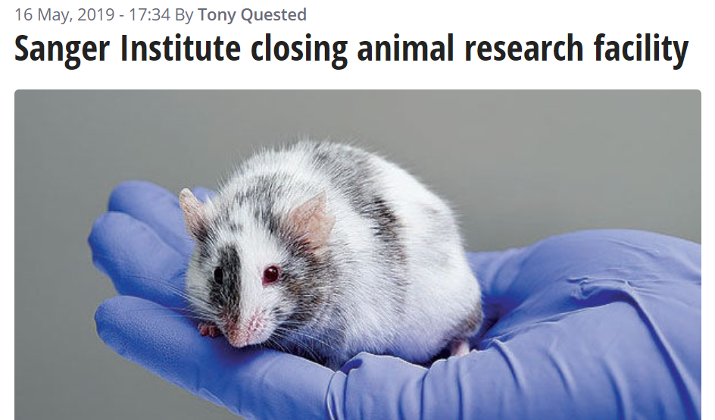
Responses to evidence - funders
MRC 2019
long-term ambition - to fund exploration of emerging technologies, e.g. 3D tissue models and organoids (2019 Annual Delivery Plan)
recommended closure of all academic work at Mammalian Genetics Unit (Harwell Institute), stating recommendation to close site was ‘… a reflection of the changing scientific landscape’
Wellcome Trust 2019
announced closure of animal breeding facility at Sanger Institute within 3 years, stating scientific strategy changing and new techniques, e.g. development of tissue culture / organoids allowed possibility of reducing animal studies

Slide 30
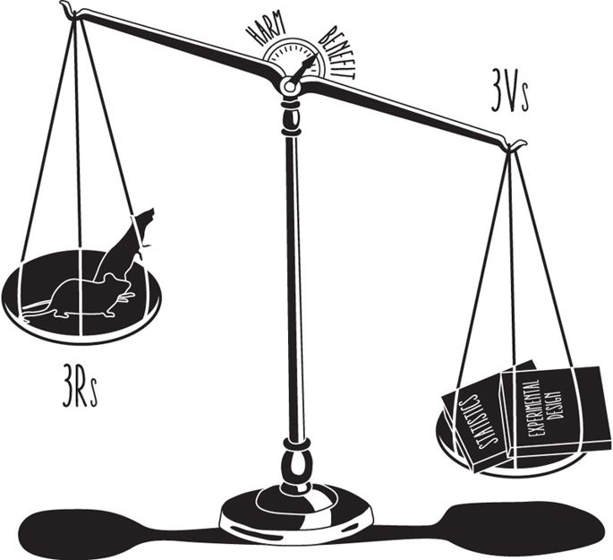
Responses to evidence – scientists, applied ethicists
Scientists aim to improve quality of animal research, in hope this will improve clinical translation, i.e.
Add 3Vs (internal, external, construct Validity) to 3Rs (Sena & Curry 2019)
Expand 3Rs to include Robustness, Registration and Reporting (Strech & Dirnagl 2019)
Applied ethicists
Some agree with scientists, i.e. increase likelihood of benefit by improving research design/ validity of animal studies (Kimmelman & Henderson 2016; Meijboom et al 2020)
Some propose ways to improve assessment of benefits during HBA process (Kimmelman & Henderson 2016)
One group proposes relaxing licensing and approval - animal research can only be expected to produce knowledge, not benefits (Eggel et al 2020)

Slide 31
Part 4
Going forward

Slide 32
Ethical implications of poor quality research & low rates of clinical translation
Poor quality animal studies produce untrustworthy findings
Uncertainty about clinical benefit
Undermines justification for animal research
Animals’ suffering loses moral justification because they cannot contribute to clinical benefit
Poor clinical translation
Selective reporting / negative findings not published
Animal studies may be repeated unnecessarily
Undermines 3Rs (Reduction)
Creates potential risk clinical trial participants
Unmet need – no treatments for 100s of human diseases

Slide 33
Historic lack of ethical engagement with animal research regulations
Hvitved (2020): animal research regulations developed by research community - no input from ethicists – contrast with ethicists engagement with human research regulation
Belmont Report (US), Declaration of Helsinki lay out foundational ethical principles to guide development of regulations - animal research regulations do not benefit from underlying ethical principles
Scientific interest remains at centre of laboratory animal research regulations - assumption that animal research necessary
In absence of ethical input, animal protection organisations shape discussions about ethics

Slide 34
Nuffield Council on Bioethics report, 2005
Took position that:
research involving animals have provided benefits to society
animals can be useful for studying aspects of human biology / disease
Advocated continued weighing on case by case basis (HBA) and continued use of 3Rs, albeit with greater emphasis on Replacement
Working party of 18, of which 3 working in philosophy / ethics

Slide 35
Oxford Centre for Animal Ethics report, 2015
Know more about extent / range of how animals can be harmed, i.e. they experience pain, shock, fear, foreboding, trauma, anxiety, anticipation, terror etc.
Animals have worth in themselves, not just tools for human use
Some factors commend animals as subjects of special moral solicitude, e.g. unable to give consent / represent own interests
Regulations do not protect animals
An ‘overconfidence’ in animal experiments as a scientific technique
‘We cannot avoid the conclusion that animal experimentation represents the institutionalisation of a pre-ethical view of animals’
Working party of 20 academics, 7 of whom working in philosophy /ethics

Slide 36
Thoughts/ questions about way forward
Both reports have been largely ignored – no impact on regulations
Agree with moral philosophers that current situation not morally responsible / ‘pre-ethical’ – but what to do?
Is it ethical to continue trying to make animal models work as scientists/ applied ethicists suggest?
Little evidence that guidelines /checklists improve animal study quality (STAIR 2009)
Even if animal studies conducted perfectly, animal-human species differences would continue to make translation of data from animal to humans unreliable
Applied ethicists appear to have adopted scientific agenda – helpful? Or more independence preferable?
Ethical input needed to overhaul/ replace HBA and 3Rs
Foundational ethical principles needed to underpin animal research policy and regulations
Animal research traditionally a closed community - how to get ethicists/ philosophers together with regulators / policy makers?

Slide 37
Thank you
pandora@safermedicines.org

